Slide 1
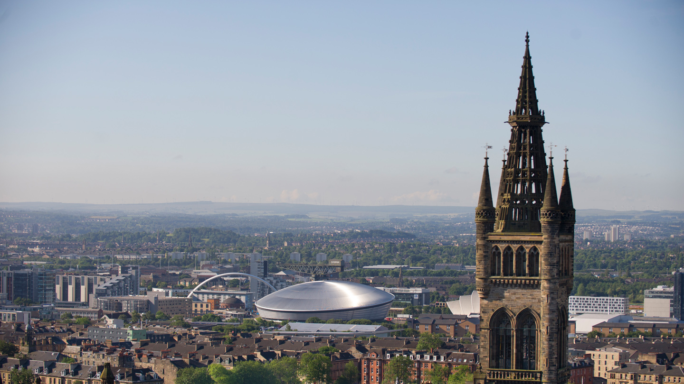
IHW Town Hall Meeting Thursday 21 January 2021 11.30-12.30

Slide 2
Please ask questions via Chat to Asha or ‘Everyone’ or by raising your virtual ‘hand’
All IHW guidelines https://www.gla.ac.uk/researchinstitutes/healthwellbeing/guidelines/
IHW guidance on good practice for remote studying for PGT and PGR students
https://www.gla.ac.uk/researchinstitutes/healthwellbeing/guidelines/remotestudy/
IHW guidance on good practice for remote working
https://www.gla.ac.uk/researchinstitutes/healthwellbeing/guidelines/remoteworking/
Tax relief at https://www.gov.uk/tax-relief-for-employees/working-at-home
Online suggestions and will be treated in confidence if you wish and can be submitted anonymously https://www.gla.ac.uk/researchinstitutes/healthwellbeing/staffstudent/suggestions/

Slide 3
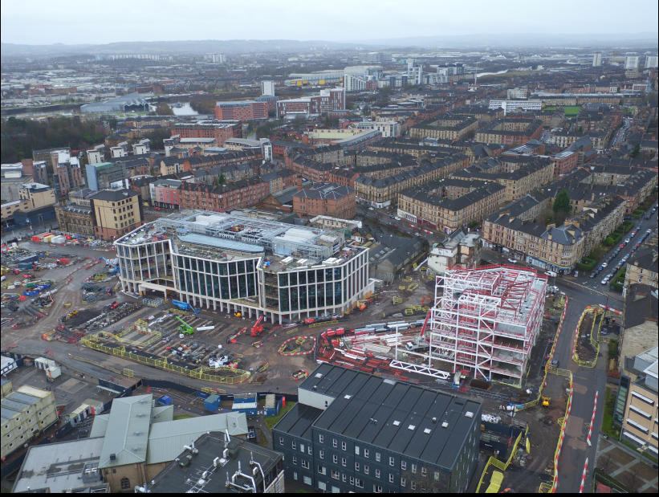
Advanced Research Centre (ARC)
Clarice Pears
Drone Progress Photographs taken 17th January 2021

Slide 4
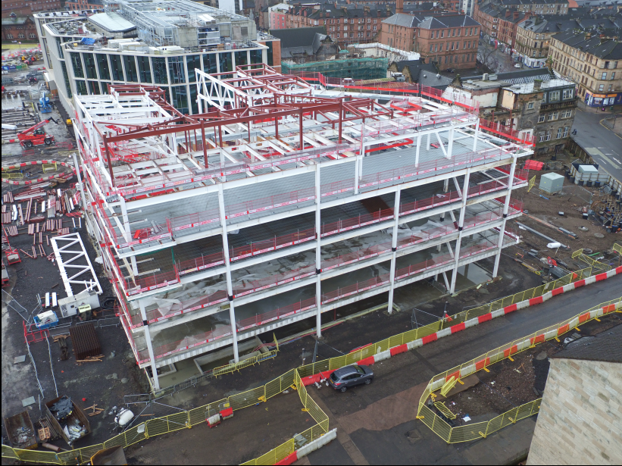
Byres Road
University Place
Drone Progress Photographs taken 17th January 2021

Slide 5
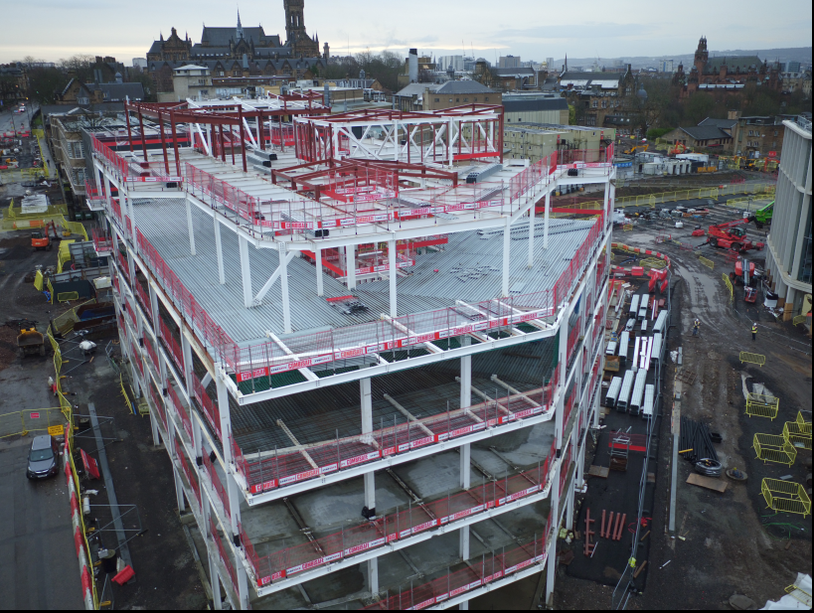
Drone Progress Photographs taken 17th January 2021

Slide 6
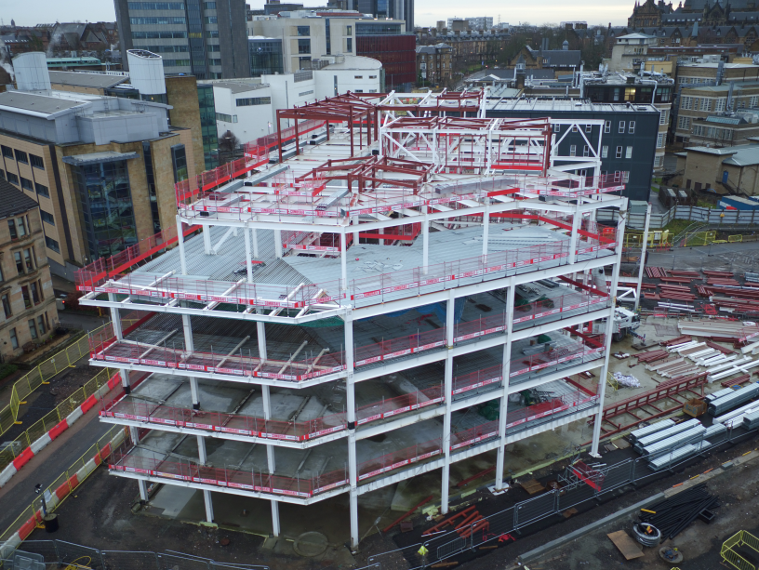
Drone Progress Photographs taken 17th January 2021

Slide 7
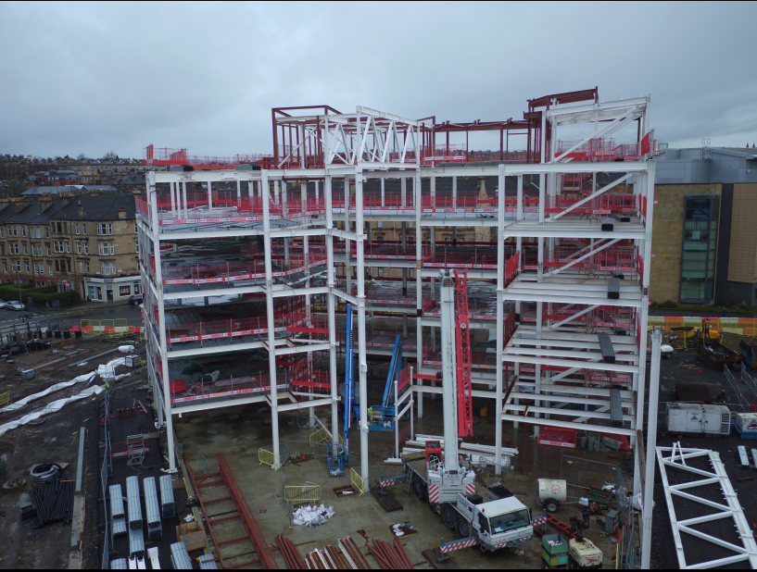
Byres Road
Drone Progress Photographs taken 17th January 2021

