Slide 1

3-4 October 2024
Mixed Migration Centre
PACES, WP5 Insights
Empowering Migration Researchers
12 December 2024
Chloe Sydney – Global 4Mi and Data Coordinator

Slide 2



Please download and install the Slido app on all computers you use
Join at slido.com
#1081497
ⓘ Start presenting to display the joining instructions on this slide.

Slide 3

Please download and install the Slido app on all computers you use
Which of these population groups engage in mixed migration?
ⓘ Start presenting to display the poll results on this slide.

Slide 4
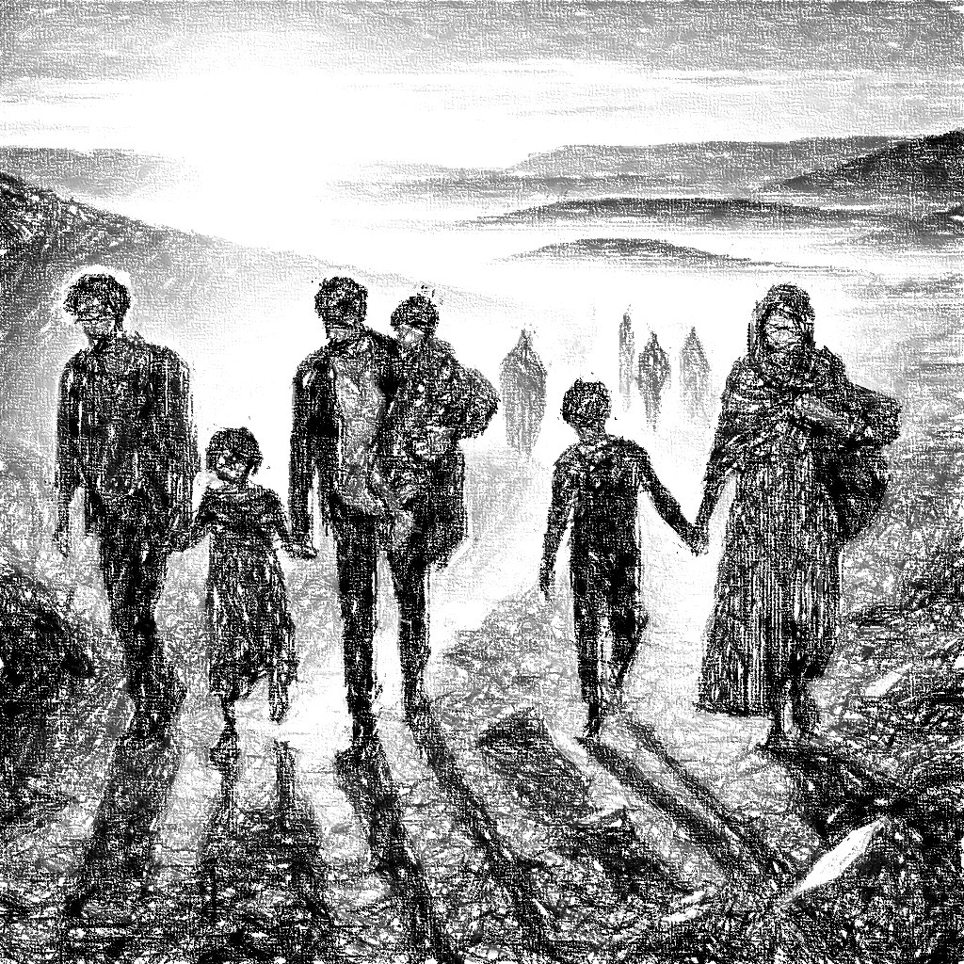
Mixed Migration
Cross-border movements of people, including refugees, victims of trafficking, and people seeking better lives and opportunities, motivated to move by a multiplicity of factors, with a range of legal statuses and a variety of vulnerabilities, traveling along similar routes, using similar means of travel – often traveling irregularly, and wholly or partially, assisted by migrant smugglers.
Notes:
Picture by ChatGPT

Slide 5
MMC’s objectives
To contribute to a better, more nuanced and balanced understanding of mixed migration (knowledge)
To contribute to evidence-based and better-informed migration policies and debates (policy)
To contribute to effective evidence-based mixed migration responses for people on the move (programming)

Slide 6
What is 4Mi?
4Mi collects globally comparable primary quantitative data on mixed migration
A network of about 165 enumerators (often migrants) conduct individual interviews with people on the move in around 20 countries
Around 15,000 interviews are conducted every year; the database has over 75,000 respondents to date
Limitations
4Mi replies on a combination of purposive and snowball sampling. Findings are not representative, but nonetheless very indicative given the volume of data collection.
Notes:
Flagship primary quantitative data collection programme

Slide 7
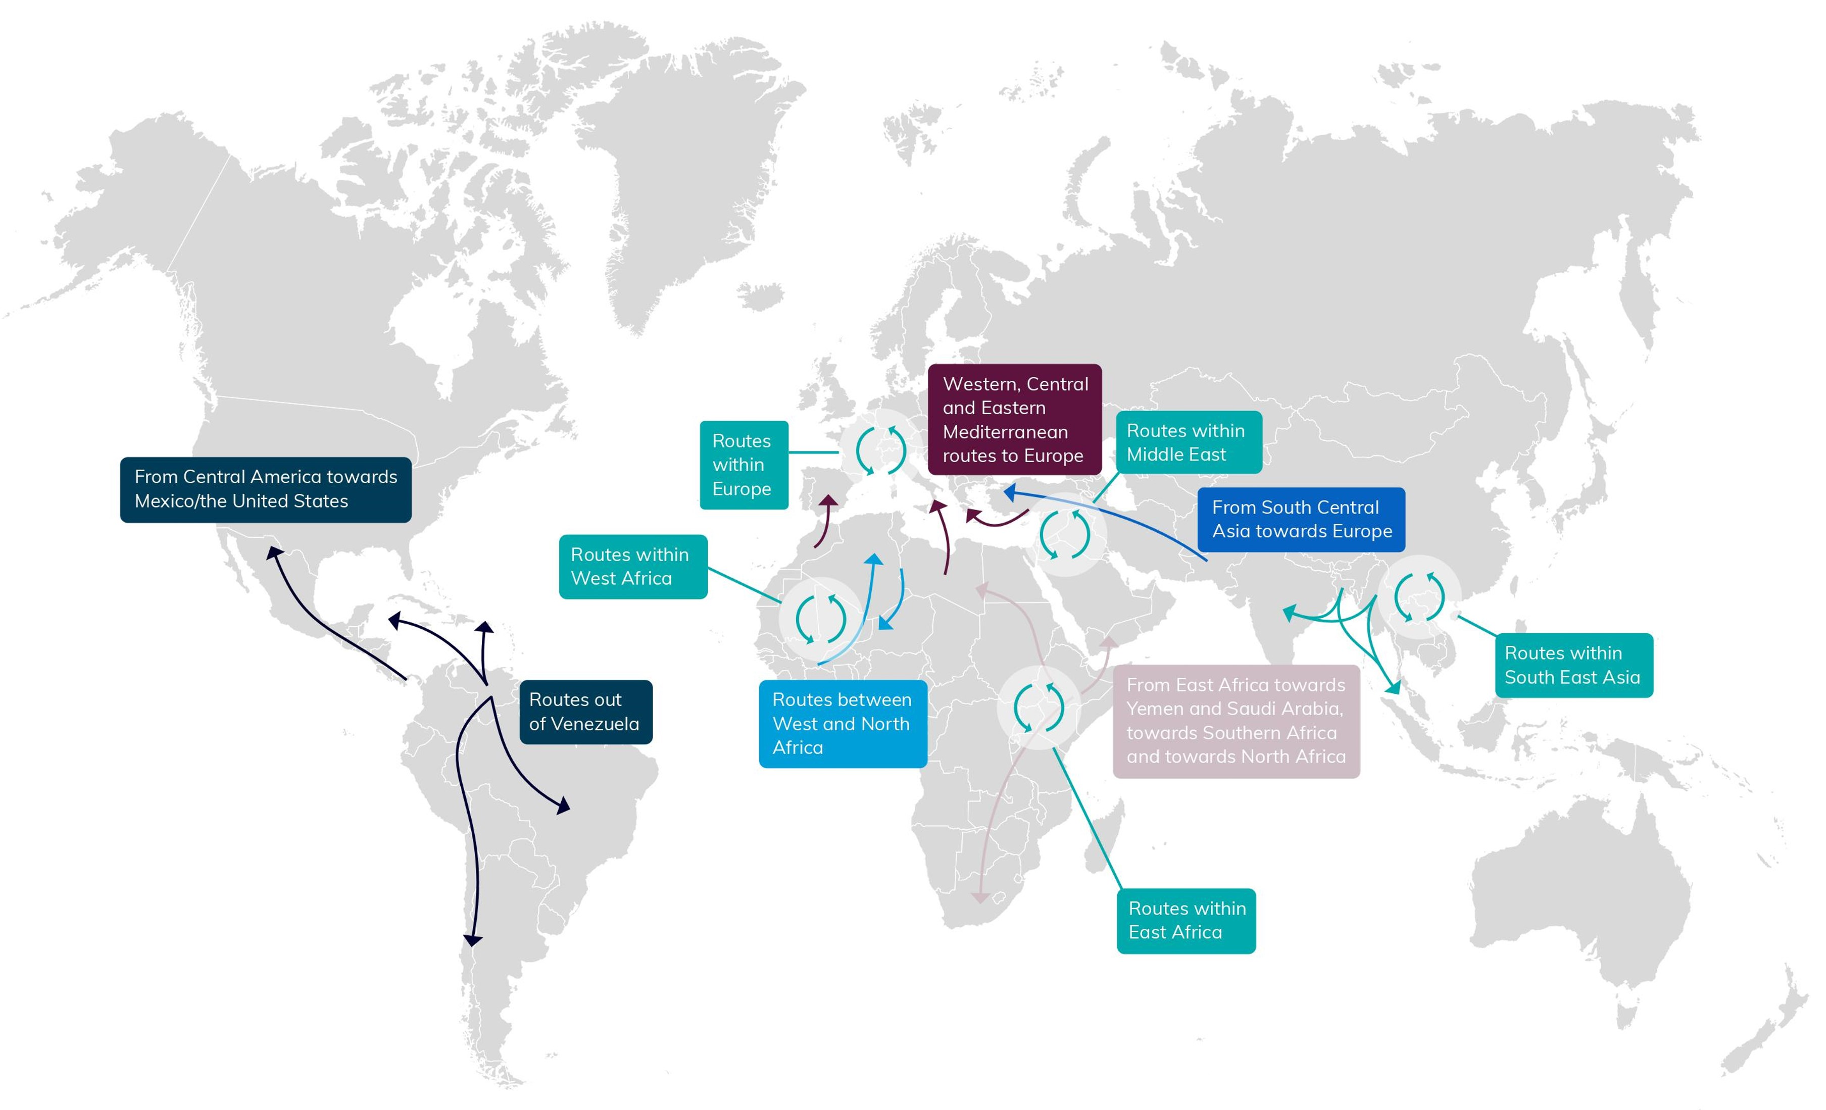
Geographical focus

Slide 8
Who are on mixed migration routes?
Why did they leave? Where do they want to go and why?
What route has been taken? Countries transited and places stopped
Perceived risks on the journey
Access to assistance and needs
Influences and access to information
How the journey was financed
Experience with smugglers
Insights from 4Mi
One core standardised survey, with optional modules on specific themes
(e.g. youth and caregivers, climate, decision-making, smuggling, SOGIESC…)

Slide 9





Additional 4Mi surveys
Longitudinal survey
4Mi Cities
Returns survey
Covid19 survey
Smugglers survey

Slide 10
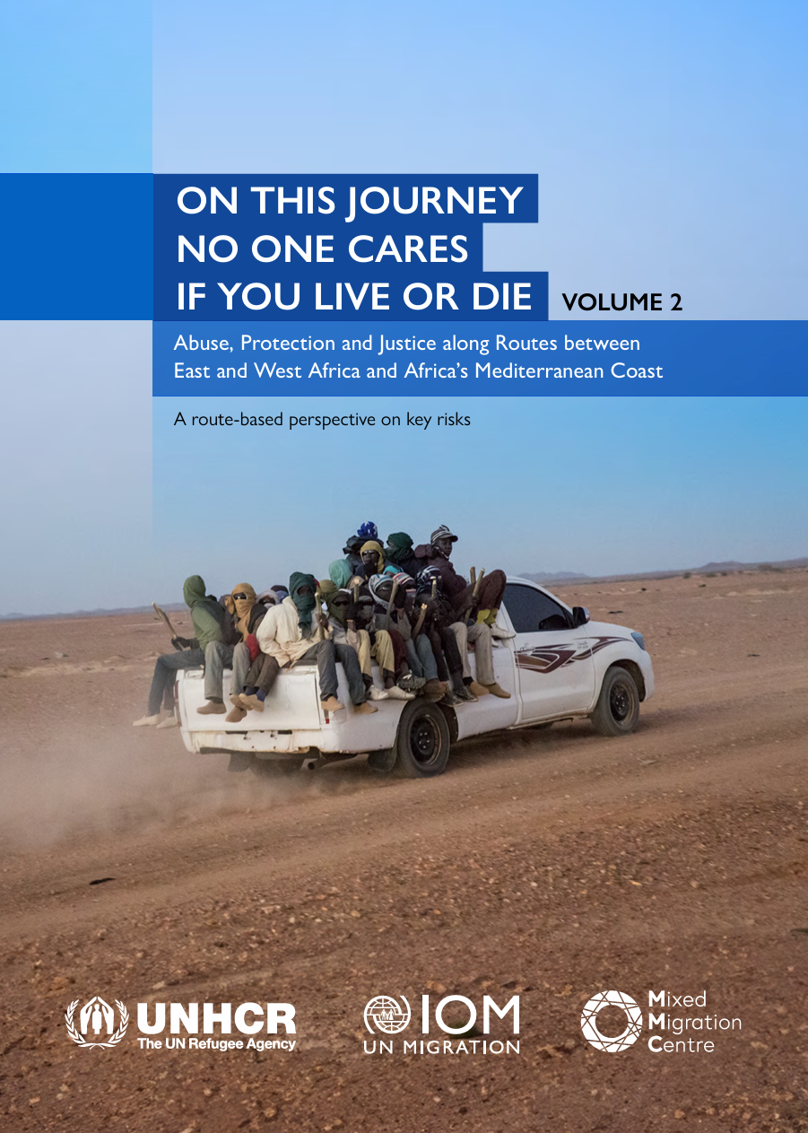
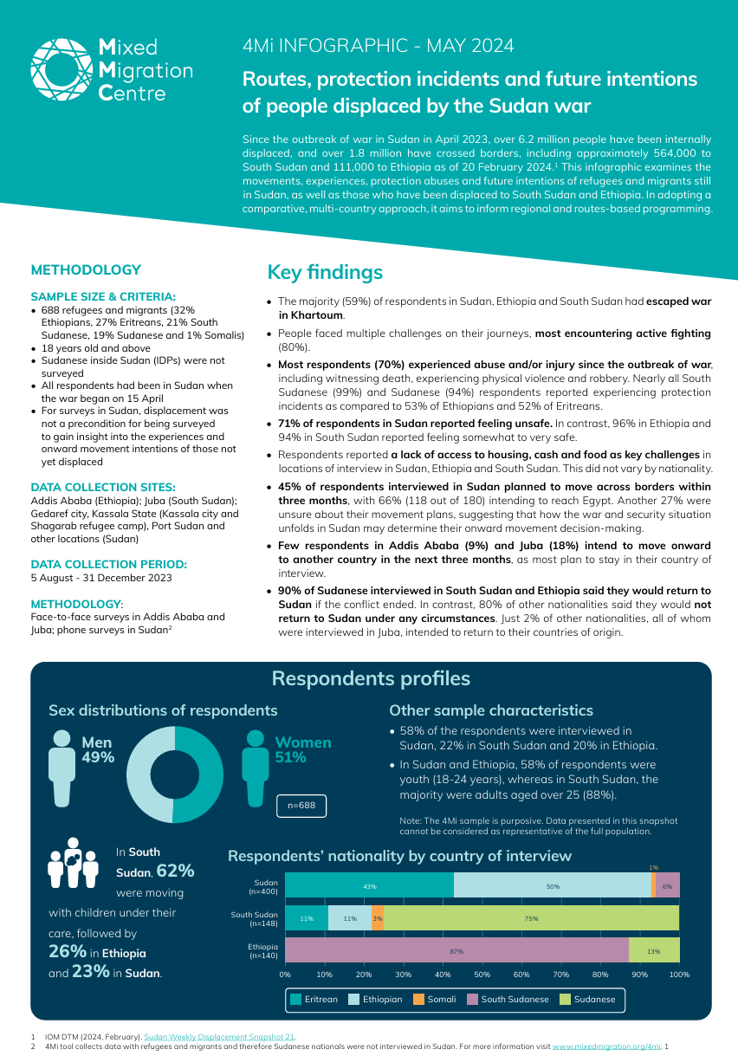
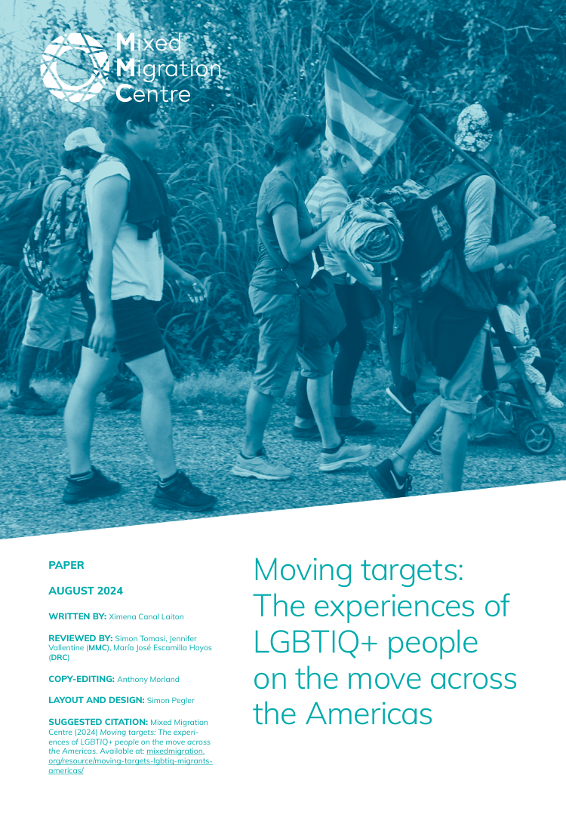
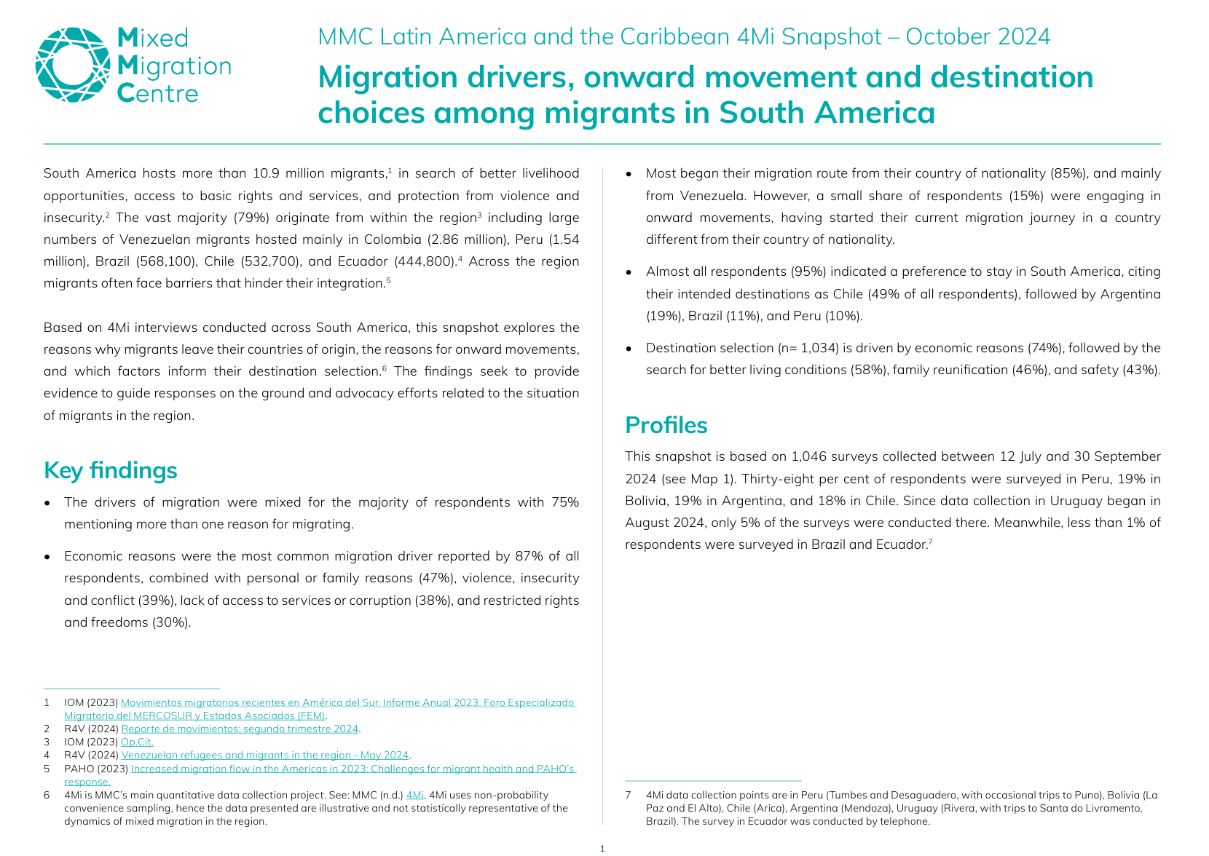
Recent highlights and insights

Slide 11
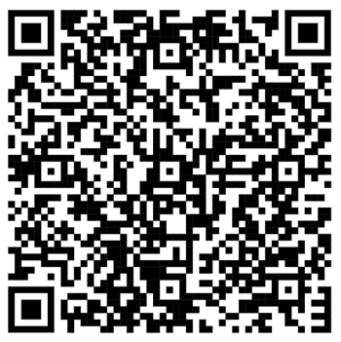
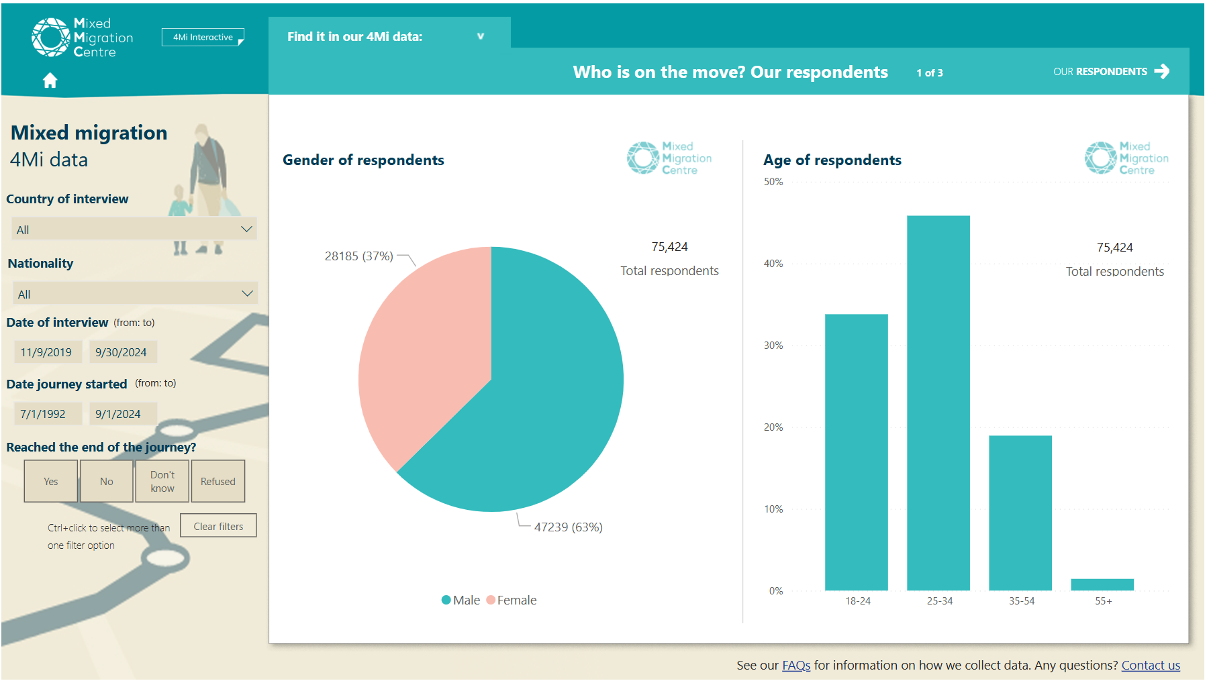
4Mi Interactive

Slide 12
Please download and install the Slido app on all computers you use
Which nationality accounts for the highest percentage of respondents interviewed in Europe?
ⓘ Start presenting to display the poll results on this slide.
Notes:
Caveat: this does not mean that a plurality of migrants in Europe are Afghans, just that among respondents Afghans are the largest group. Keep in mind our data is not representative!

Slide 13
Please download and install the Slido app on all computers you use
What percentage of respondents from Eritrea cite 'rights and freedoms' as a reason for migration?
ⓘ Start presenting to display the poll results on this slide.
Notes:
Note: 77% is for male Eritreans; 27% is for all respondents.

Slide 14
Please download and install the Slido app on all computers you use
What is the main risk for children according to respondents in Latin America and the Caribbean?
ⓘ Start presenting to display the poll results on this slide.

Slide 15
Please download and install the Slido app on all computers you use
In which of these countries of interview do respondents most feel they were misled by their smugglers?
ⓘ Start presenting to display the poll results on this slide.
Notes:
Note: notice that in fact this is not as common as you’d expect.

Slide 16
Please download and install the Slido app on all computers you use
Among women aged 18-24 interviewed in 2023, how many would have started their journey knowing what they know now?
ⓘ Start presenting to display the poll results on this slide.

Slide 17
Questions?

Slide 18
Contact: chloe.sydney@mixedmigration.org
www.mixedmigration.org/4mi
MMC is a leading source for independent and high-quality data, research, analysis and expertise on mixed migration. MMC aims to increase understanding of mixed migration, to positively impact global and regional migration policies, to inform evidence-based protection responses for people on the move and to stimulate forward thinking in public and policy debates on mixed migration. MMC’s overarching focus is on human rights and protection for all people on the move

