Slide 1
School of Physics & Astronomy
Class & Lab Head Guidance
Dr Peter H. Sneddon
Peter.Sneddon@Glasgow.ac.uk

Slide 2
Note on timeline
The timeline discussed here assumes the course you are running lasts throughout Semester 1 and 2.
The details of duties etc is broadly identical if your course only runs for one semester, but the specifics for the times may differ. If you are uncertain about timings, please consult previous class head, or feel free to speak to the School’s Convenor of Learning & Teaching.

Slide 3
August
Course enrolment opens through MyCampus
~10th August for continuing undergraduate students
~15th August for MSc students
~20th August for new undergraduate students
Before this happens you must ensure that the course is set up correctly within MyCampus
Is there an enrolment section associated with the course?
Are all the different class sections in place?
Are the capacities for those sections correct?
All of this should have been set up with support from the Teaching Support Team in February/March.

Slide 4
August
MyCampus access
As a class head you need to make sure you have the correct access rights within MyCampus. You need to be able to access …
Main Menu – Curriculum Management – Class Roster – Class Roster
Main Menu – Curriculum Management – Schedule of Classes – Update Sections of a Class
Main Menu – Curriculum Management – Grading – Grade Roster
Main Menu – Curriculum Management – Student Good Cause
We’ll come back to these later on.
To gain the correct access rights, please visit
https://www.gla.ac.uk/myglasgow/mycampussupport/mycampus%20access/#studentrecordsaccess

Slide 5
August
Once course enrolment opens you should …
Expect queries from new students – is this the right course? When does it start?
Expect queries from Adviser of students – can my student take this course? Is it suitable?
Keep an eye on enrolments in class subsections (e.g. Lab groups) – are you getting an even distribution across all sections? Do you want to “massage” section sizes temporarily to encourage an even distribution?

Slide 6
August
You should prepare the lecture allocations for your course
Alll teaching allocations are assigned to your course by the School Registrar. (David Miller currently)
Lecturers, demonstrators, tutors etc
You should be able to see who has been assigned by generating a class head report …
Go to the School’s website at https://www.gla.ac.uk/schools/physics/
Follow link to “Information for Staff”, then “Staff Database”
Log in with your School GUPHYS ID and click on “Staff Database”
“Administer the database” – set “Department” to ”Physics & Astronomy
Under “Admin” select “Teaching Allocation”
Then under “Reports” select “Class Head reports” and select your course. (You also need to set the year to the current term – box at top left.)
To gain access to GUPHYS email phas-it@glasgow.ac.uk

Slide 7
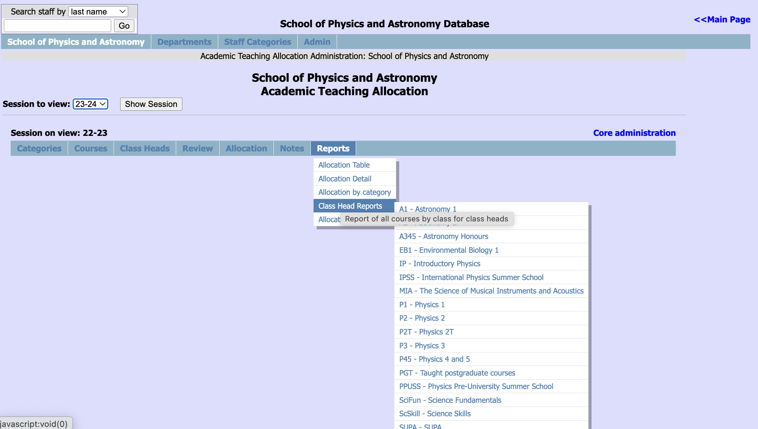
August

Slide 8
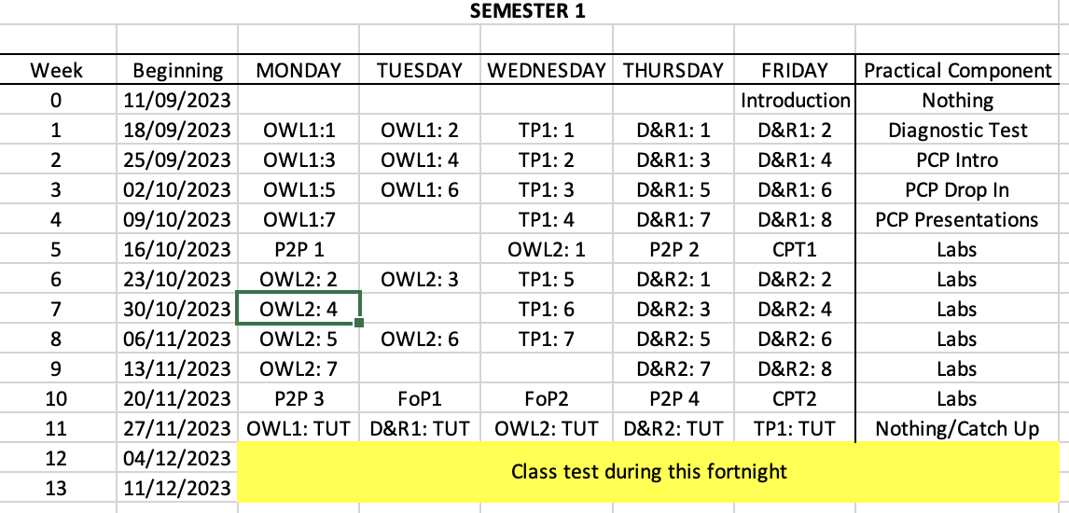
August
For Honours years, lecture sessions are set centrally, so there is nothing for you to do.
For non-Honours years, your course will contain a series of modules, and you need to sort who precisely who will be lecturing each day.
E.g. …

Slide 9
August
Arrange a pre-semester meeting with your lecturing team and support staff
Allows you to set out your expectations on staff
Allows your staff to ask any questions they might have

Slide 10
September
Set up your Course Moodle site(s)
Tom Queen – Chief Technician – archives all Moodles each year, cloning the previous years to create the next year.
You need to make sure that anything you want hidden from students at the start of the year is hidden.
As soon as students enrol on your course they will have access to the Moodle site (or from the date the site is set to open, depending on when they enrol)
Make sure to remind your lecturers that it is their responsibility to maintain the part of the Moodle relating to their course/module.

Slide 11
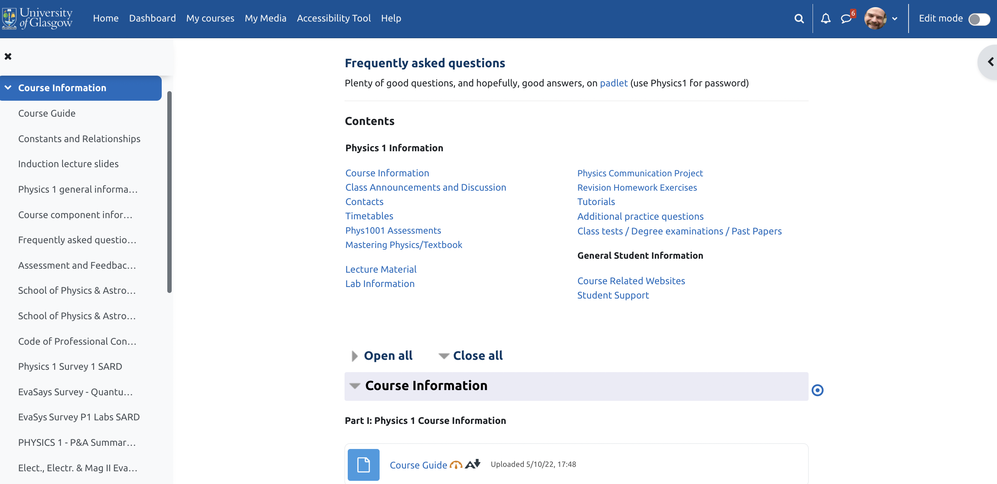
September

Slide 12
September
Moodle is our main point of contact for students
Messages sent to the Class News Forum automatically get forwarded to student emails, so they have no excuse for missing messages.
All examinable material must be made electronically via Moodle by the time assessments of that material come round.
Uploaded documents should be as accessible as possible.
The Teaching Support Team and/or the Technician Team can help you get everything set up.

Slide 13
September
We are not meant to keep pdf timetables on Moodle.
Students should be told to either …
Log in to the University’s website and go to “Timetables and Room Booking” link, select the “Timetable Viewer” tab and then enter their course, or
Download “UofG Life” app for their mobile device which they can then log in to with their GUID – this should show them all of their classes and where they are
We ARE allowed to keep local timetables with details of which module is on which day, but these should not include the venues.
Minimises risk of students going to the wrong places.

Slide 14
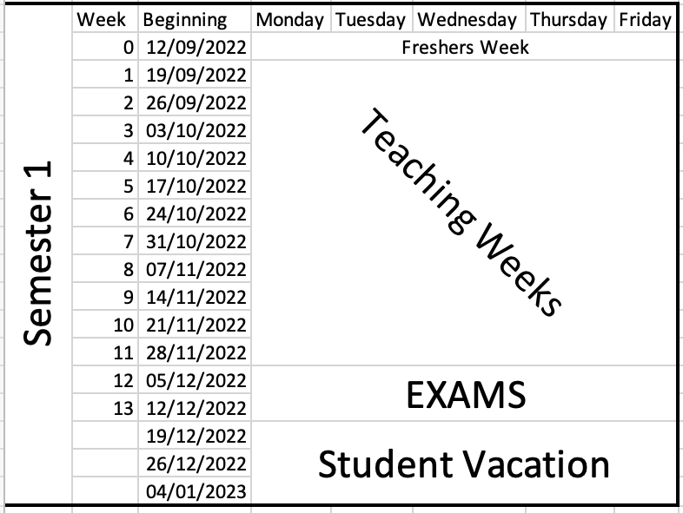
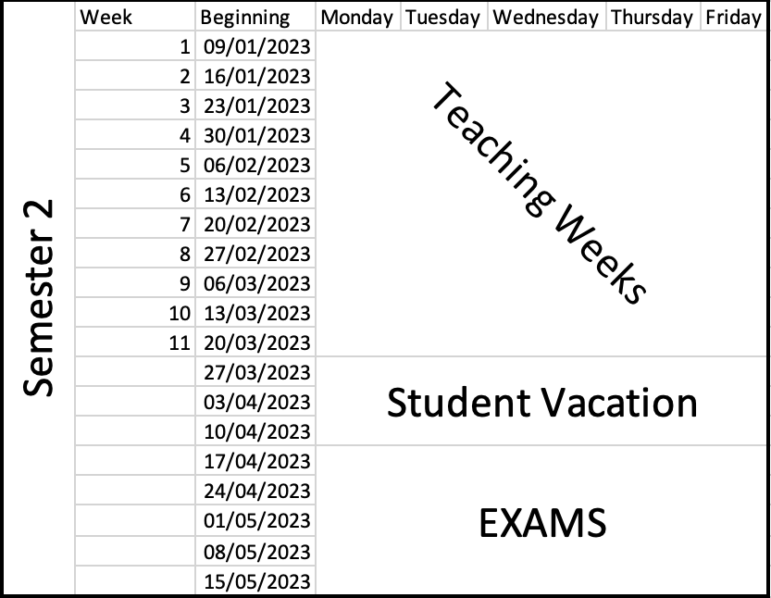
September
Teaching runs for 22 weeks, split into two semesters.

Slide 15
September
Courses begin with an Induction session, either at the end of Freshers week, or the beginning of week 1.
Purpose of Induction
Say hello
Explain what the course is and who it is for
Set out clearly what you expect the students to do
Set out clearly what the students can expect from you
Highlight how they can contact you if they need to
Explain what to do if they are absent from the course – Good Cause Claims
Summarise content – both in terms of subject matter and skills that they’ll develop/improve

Slide 16
September
Class representatives
All classes have student representatives who act as the liaison between their classmates and the School.
How many your class has depends on the class size
Up to 50 – 1 or 2
51 – 150 – 2
150 or more – 3 or 4
They – and you – are part of the Staff-Student Liaison Committees.
The School has 2 – one for levels 1 and 2, and one for Honours years

Slide 17
September
Class representatives
You need to run an election early in Semester 1 (or 2 if your course only runs then)
Format is up to you
In person
On moodle
Good practice is to ask for people to volunteer and then get those candidates to put together a short – 200-300 words – “Why me” message for the class
Once you have your reps, pass details to the School’s TST
(Students then get offered training from the SRC.)

Slide 18
September
Class representatives
You can learn more at
Staff Tool Kit
https://www.gla.ac.uk/myglasgow/students/studentrepresentationtoolkit/stafftoolkit/
Code of Practice
https://www.gla.ac.uk/myglasgow/apg/qea/studentrepresentationmyclassreps/codeofpractice/

Slide 19
September
Class representatives
The SSLCs meet once per semester
Good practice to meet with your own class reps ahead of those meetings so there is a chance to discuss solutions to problems at the meetings

Slide 20
September
Class sub-groups
Supervisions
If your class has Supervisions you will need to decide how to divide the class up
You will be assigned a team of staff to run these as they see fit
Supervisors may need encouraging/reminding to sort out their students into groups and arrange meetings
Lab Groups
Students will have selected a specific lab day or group in MyCampus when the enrolled on the course
If you then need them to choose experiments or put themselves into sub-groups you’ll need to work out how.
Moodle Choice can help
Speak to the Technicians.

Slide 21
September
Students with special needs
Students with additional need can register with the Student Disability Service https://www.gla.ac.uk/myglasgow/disability/
This can entitle them to additional provisions for classes and assessments
Can include
Permission to record lectures
Flexibility with deadlines
Extra time in examinations
Separate rooms for examinations
School’s Disability Coordinator will contact you with details for your course.
Best to then discuss with individual students

Slide 22
September
Students with special needs
You can identify such students on your course in MyCampus using the following query:
Main Menu – Reporting Tools – Query – Query Viewer
UOG_DISABILITY_BY_CLASS_ENR
Set “Institution” to “GLSGW”
Set “Subject” to “PHYS” or “ASTRO”
Set “Catalog” to the 4 digit code for your course. E.g Physics 1 = “PHYS” and “1001”
Set “Term” to current academic. E.g. 2023-24 = “2023”

Slide 23
September
Good Cause Claims
If students miss an assessment, or a course component that contributes to their course grade, they should log a Good Cause Claim.
Details on how to do this should be contained within the Course Guide.
They do this through their MyCampus account, via their “Student Centre”
Once the claim is submitted three people (set within MyCampus) will receive an email notification and be able to access the details:
“Course Coordinator” – usually set as Class Head
“Good Cause Coordinator” – usually set as Lab Head or Class Deputy Head
“Course Administrator” – usually set as a member of the TST

Slide 24
September
Good Cause Claims
https://www.gla.ac.uk/myglasgow/apg/policies/assessment/goodcausefaqs/
They are designed to be used for unexpected events – illness, accident
Should not be used for chronic conditions – issues that run on for weeks/months
Decisions on whether to accept/decline GCCs for continuous assessment should be made by the class head within 1-2 weeks at most
Decisions on whether to accept/decline GCCs for examinations are made by the School’s Good Cause Claim Committee, which meets January, June and August.
Chair of GCC Committee happy to offer advice on any claims – Peter Sneddon

Slide 25
September
Good Cause Claims
https://www.gla.ac.uk/myglasgow/apg/policies/assessment/goodcausefaqs/
We do not usually insist on supporting evidence for one-off continuous assessment absences/affected performances
We DO insist on supporting evidence for claims relating to examinations

Slide 26
October/November
Once the course is up and running, your role is basically supervisor …
Keep an eye on attendance
Keep an eye on performance/engagement in any assessments
Respond to any student queries
Make sure lecturers are uploading notes, responding to queries, etc
Post regular messages to class if there are important events coming.
Making decisions on any GCCs
If you are seeing students who are missing a lot of the course, make sure to pro-actively try to engage with them. An email is usually sufficient to get things going. If you struggle to make contact, though, you should get in touch with the student’s Adviser of Studies and/or the School’s Student Support Officer

Slide 27
October/November
People you can contact if you are concerned about a student …
Their Adviser of Studies - details can be found on MyCampus – Main Menu – Records and Enrollment – Student Summary.
The School’s Senior Adviser of Studies – Dr Donald MacLaren on phas-senioradviser@glasgow.ac.uk
The School’s Student Support Officer – Mara Dougall on phas-studentsupport@glasgow.ac.uk
The College Chief Adviser of Studies – Dr Peter H Sneddon on science-chief-adviser@glasgow.ac.uk

Slide 28
November/December
Preparation of Degree Examinations
The majority of our degree examinations are held in the May exam diet, though a small number run in the December diet.
Preparation of exam papers for Honours years is led by the School’s Honours Exam Committee, with initial calls for questions usually going out early in Semester 1.
Preparation of exam papers for non-Honours years is led by the Class Heads

Slide 29
November/December
Preparation of Degree Examinations and Resit Examinations
There are multiple stages in preparing the exam papers for level 1 and 2 courses
The precise dates vary from year to year, but the approximate pattern is as follows:
Deadline (all Semester 2) | Detail
End of Week 3 | 1st complete draft of exam paper(s) sent to School’s non-Honours exam chair for relaying to the School’s Internal Checker
Beginning Week 7 | Feedback from Internal Checker returned to Class Heads
End of Week 7 | Revised papers returned to non-Honours exam chair for relaying to the External Checker
Beginning Week 10 | Feedback from External Checker returned to Class Heads
End of Week 11 | Final version of papers returned to non-Honours exam chair
Strongly encourage you ask lecturers for questions as early as possible.

Slide 30
November/December
Preparation of Degree Examinations and Resit Examinations
It is possible to re-use previous resit examination papers at non-Honours.
Alternatively, you can ask your lecturers to create new ones each year
Re-use is permitted provided you are 100 % certain that the papers have never been released electronically. If they have, they are considered “public” and cannot be re-used.
If you do wish new resits created, they should be created at the same time as the main diet papers so they can go through the same checking process.
Re-used papers usually only need to be checked by the lecturers to make sure they are still appropriate.

